Slide 1
Lecture 11
Finding Missing Components

Slide 2
What Have We Done?
Argument
Analyzing
Evaluating
Finding Logical Indicators
Finding Premises and Conclusion
Formalizing the Argument
Formal
Informal

Slide 3
Reconstructing
Diagramming Short Argument
Linked Support
Independent Support
Advanced Analysis
Analysis
Simple/ Complex Argument
Hidden Premises /Assumption
Hidden Conclusion / Implication
What is the next?

Slide 4
Simple Argument vs. Complex Argument
Simple Argument:
Arguments have only single conclusion and without any sub-conclusion.
Complex Argument:
Argument contains at least one sub-conclusion.
A main argument that supported at least by one sub-argument.

Slide 5
Simple Argument vs. Complex Argument
Simple Argument
P1: XXXXXXX
P2: XXXXXXXXX
P3: XXXXX
C: Therefore, XXXXXXXX
Complex Argument
P1: XXXXXX
P2: XXXXXXXXX
C1: XXXXX
P3: XXXXXXX
P4: XXXXXX
C: XXXXXXX
Sub-Conclusion
Main Conclusion

Slide 6
Complex Argument
P1.: During a trip people often need to collect packages or toddlers.
P2: It is not private (a kind of emotional inconvenience)
C1: Public transportation is inconvenient
P3: People’s home and work are spread thinly for the hub-and-spoke system necessary for a public transportation system.
P4: The car is always more accessible, and so perceived as more useful than public transportation.
C2: Public transportation is often useless.
C: Malaysians are less likely than ever to use public transportation.
P1: The Federal Reserve has indicated that interest rates will rise.
C1: Therefore, interest rates will rise.
P2: If interest rates rise, stock market prices will fall.
C: Therefore, stock market prices will fall this coming quarter.

Slide 7
Complex Argument
Possible Problems
Missing gaps between lines
Complicate structure
Imprecise and unclear expression
Why happens?
Intentional or unintentional
Avoid tedious?
Hint?
Conceal weakness or questionable statement

Slide 8
Finding Missing Components
Hidden conclusion
Hidden premises
Major assumption
Value assumption
Factual Assumption
Implications

Slide 9
Missing Components in Argument
Hidden Premises
Hidden Conclusion

Slide 10
Missing Components in Argument
Consider these arguments:
Sally can’t drive because she doesn’t have a driver’s license.
Boxing should be banned because it’s dangerous.
If I’m Bill Gates, I’m rich. Hence, I’m not Bill Gates. Hence, I’m not the chairman of Microsoft.
At first sight, these arguments make sense and seem to be valid.
However, these arguments are invalid until we find out the missing components.

Slide 11
Hidden Premises
Hidden premises are unstated claims, without which there is no way to move from the explicit premises to the conclusion.
Why missing link does matter? Once you find out the missing link, you…
Make the argument sensible and understandable.
Make the argument valid or strong.

Slide 12
Hidden Premises
Example 1:
Sally can’t drive because she doesn’t have a driver’s license.
P1 : Sally doesn’t have a driver’s license.
C : Therefore, Sally can’t drive.
HP1: No one can drive without a driver’s license.
P2 : Sally doesn’t have a driver’s license.
C : Therefore, Sally can’t drive.
Invalid!
Valid!

Slide 13
Hidden Premises
Example 2:
Boxing should be banned because it’s dangerous.
Formalization:
P1: Boxing is dangerous.
C: Boxing should be banned.
Form:
P1: Boxing is dangerous.
HP1: All dangerous activity should be banned.
C: Boxing should be banned.
P1: X is Y
C: X is Z
P1: All X is Y.
P2: All Y is Z.
C: All X is Z.
Invalid!
Valid!

Slide 14
Hidden Premises
P1: If X then Y.
C1: Hence, Not X.
C2: Hence, Not Z
P1: If I’m Bill Gates, I’m rich.
HP1: I’m not rich.
C1: Hence, I’m not Bill Gates.
HP2: Bill Gates is the chairman of Microsoft.
C2: Hence, I’m not the chairman of Microsoft.
Example 3:
If I’m Bill Gates, I’m rich. Hence, I’m not Bill Gates. Hence, I’m not the chairman of Microsoft.
Formalization:
P1: If I’m Bill Gates, I’m rich.
C1: Hence, I’m not Bill Gates.
C2: Hence, I’m not the chairman of Microsoft.

Slide 15
Hidden Premises
Example 4: Female infanticide
P1: We ought to respect human life.
P2: We are unable to nourish and raise the babies.
C: Therefore, we ought to kill the female babies.
P1: We ought to respect human life.
P2: We are unable to nourish and raise the babies.
HP1: Men are predominant over women in our society.
C: Therefore, we ought to kill the female babies.

Slide 16
Guidelines for finding hidden premises
Identify conclusion and premises and put them into standard argument form.
Think whether the conclusion is logically follows from the premises. If not, there might be missing premise(s).
Please bear Principle of Charity (making sensible) in mind and avoid Fallacy of Strawman (distort intentionally).
P1: The wind is from the south.
C: There will be rain.
P1: The wind is from the south.
HP: Around here, south winds are usually followed by rain.
C: There will be rain.
P1: The wind is from the south.
HP: Around here, a south wind is always followed by rain.
C: There will be rain.

Slide 17

Hidden Conclusion
An argument is said to have a hidden conclusion when its premises propose a conclusion that is left unstated.
1. Store clerk: I’m sorry, boy, underage consumption of alcohol is prohibited with no exceptions.
Hidden Conclusion:
I can’t sell you any beer.
2. The bigger the burger, the better the burger.
Hidden Conclusion:
Burgers are bigger at Burger King.

Slide 18
Hidden Conclusions
Example 3:
A nation without a conscience is a nation without a soul. A nation without a soul is a nation that cannot live.
Formalization:
P1: If a nation is without a conscience, then it is without a soul.
P2: If it is without a soul, then it cannot live.
Form:
P1: If X then Y.
P2: If Y then Z.
P1: If a nation is without a conscience, then it is without a soul.
P2: If it is without a soul, then it cannot live.
HC: Hence, if a nation is without a conscience, then it cannot live.

Slide 19
Major Assumption
Value Assumption
Factual Assumption

Slide 20
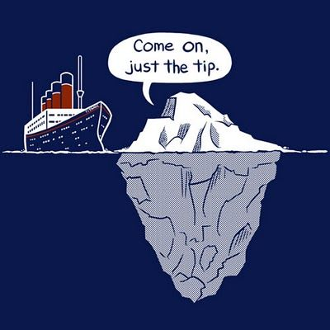
Major Assumption
…lies beneath the argument and constitute the basement of the structure.
…is something we take for granted or presuppose.
…is the fundamental factual or value beliefs that people hold for argument consciously or unconsciously.
…is a claim, which, if you knew it, would be a significant factor influencing your decision to accept that argument.

Slide 21
Two Kinds of Assumption
Value Assumption
An implicit preference for one value over another in a particular context.
We tend to take many values for granted: freedom, justice, kind etc.
Factual Assumption
An unstated belief about how the world was, is, or will become.
It has nothing to do with personal preferences or predispositions.

Slide 22
Factual Assumption
Factual Assumption:
A1: My cat is at outside.
P1: I heard a scratch at the door.
C: I got up to let the cat in.
A1: Fetus is a person.
P1: Abortion is a kind of murder.
P2: Murder is wrong.
C: Therefore, abortion is wrong.

Slide 23
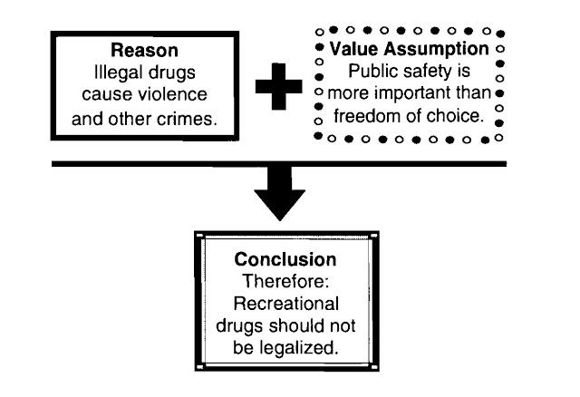
Value Assumption
P1: Street demonstration is not a Malaysian culture.
C: People should refuse Bersih campaign.
Factual Assumption:
Street demonstration is a foreign culture from western.
Value Assumption:
We should refuse foreign culture.

Slide 24
Value Assumption vs. Factual Assumption
Different Assumptions might change your viewpoint!!
Person A | Person B
Situation: A man is lying in the gutter. | Situation: A man is lying in the gutter.
Viewpoint: That man’s a bum. | Viewpoint: That man is in need of help.
Assumption: Only bums lie in gutters. | Assumption: Anyone lying in the gutter is in need of help.

Slide 25
Value Assumption vs. Factual Assumption
A1: Fetus is a person. A2: Abortion is a medical procedure used to end a pregnancy and cause the death of the fetus. | A1: Everyone has the freedom of body. A2: An abortion is the deliberate medical process of ending a pregnancy.
P1: Abortion is a kind of murder. P2: Murder is wrong. C: Therefore, abortion is wrong. | P1: Fetus is just a part of the body. P2: Abortion is a free choice of a mother on her body. C: Therefore, abortion is right.
Different assumptions might lead you to different arguments!!

Slide 26
Assumption vs. Hidden Premises
Missing Link of Premises | Assumption
Without it, the argument cannot valid or strong | Without it, the argument still be valid or strong
Making sensible and understandable. Making valid or strong. | Knowing more what argument did not say.
A1: Fetus is a person. P1: Abortion is a kind of murder. C: Therefore, abortion is wrong. | A1: Fetus is a person. P1: Abortion is a kind of murder. P2: Murder is wrong. C: Therefore, abortion is wrong.

Slide 27

Implications

Slide 28
Implication
Argument: What logically follow from the premises?
Implication: What logically follows from the conclusion?
Remarks on implication:
A way might affect (entangle) other areas outside the argument. It is often a practical upshot, or outcome, of a conclusion.
The implications might be positive, negative, neutral, or unclear.
When the implications are positive, they function as additional reasons for an argument. When the implications are negative, they function as additional reasons against an argument.

Slide 29

Implication
Why do some people oppose tourism tax?
Argument:
P1: Tourism tax can regulate the extra charges by the industry
P2: Tourism tax can increase government income.
C: Therefore, the government should impose tourism tax.
Implications: Tourists will pay higher fee for their hotel rooms.

Slide 30
Implication
Assumption 1: Nuclear power plant is the best way to supply electricity.
Assumption 2: Malaysia is suitable for developing nuclear energy.
P1: Our country needs more electrical supply for industry.
P2: Nuclear power plant is the way to satisfy the needs.
C: Therefore, Malaysia should build up nuclear power plant.
Implication 1: The country also has to accept the possible risks by nuclear power plant.
Implication 2: The country has the best to process the nuclear waste.

Slide 31
Concluding Remarks
Simple Argument is an arguments that have only a single conclusion. Complex Argument is an argument that contain at least one sub-conclusion.
An argument is said to have a hidden conclusion when its premises propose a conclusion that is left unstated.
Hidden premises are unstated claims, without which there is no way to move from the explicit premises to the conclusion.
An assumption is something we take for granted or presuppose. It is a claim, which, if you knew it, would be a significant factor influencing your decision to accept that argument.
An implication is an way a conclusion might affect (entangle) other areas outside the argument. It is often a practical upshot, or outcome, of a conclusion.

